Slide 1
Long Term Care as a Human Right: Lessons from Israel and Beyond
Prof. Israel (Issi) Doron
Department of Gerontology
University of Haifa, Haifa, Israel
“Association of
Law in the Service of the Elderly”

Slide 2
Before Opening
Movies, aging and human rights (www.geromvies.org)
I would like to introduce Mr. Carl Fredricksen
But why is he relevant?

Slide 3
OPENING
Thanks
Older Persons, GAROP & the Civil Society Organizations
UN + Chair + the Secretariat;
Israeli delegation
To the Latin American Countries: Muchas Gracias
Graphics: Denis Zilber
The Joint Submissions
The Collaborative Effort: Robin Allen, Andrew Byrnes, Nena Georgantzi, Bill Mitchell and Bridget Sleap
About this presentation
1. LTC Care in Israel & its international lessons;
2. “Measuring” and “comparting LTC HR
3. The “ideology” of the older persons HR
4. conclusion

Slide 4
Part 1: The Israeli Experience and the international lessons

Slide 5
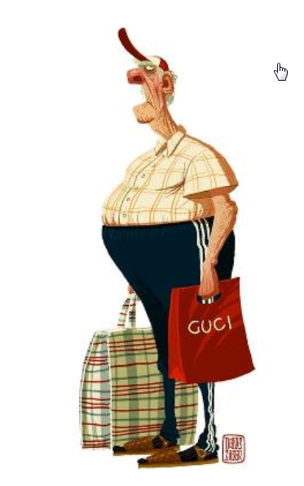
Long Term Care: in General
The universal challenges:
Definition & Terminology of LTC
The significance of LTC
The “location” of LTC
Community v. Institution
The “providers” of LTC
Formal v. informal
The “funding” of LTC
Private v. Public
The “organization” of LTC
Holistic v. Fragmented
The “quality” of LTC
Measurements; supervision; workforce;

Slide 6
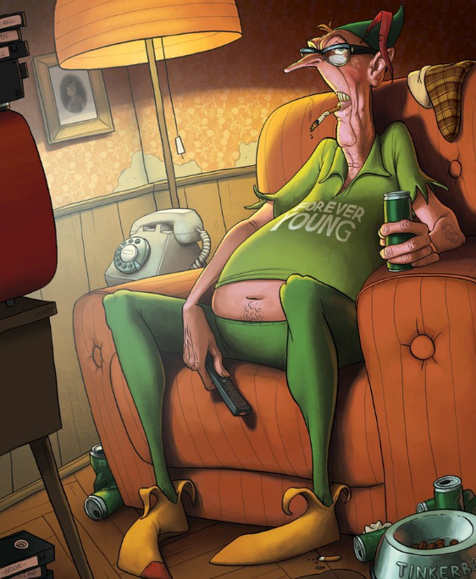
The Israeli Experience: Historical perspective
What would Mr. Fredricksen experience as an Israeli?
Prior to the 1980s:
Informal family support;
Formal needs-based “traditional” institutional-care;
No national plan or ideology;
From the 1980s to the millennium:
“Aging in Place” + Supportive communities + The Community-Based Long-Term Care National Insurance and its success;
Migrant workers + in home care;
The rise of private LTC insurance;
Still no national plan + fragmentation + paternalism

Slide 7
The Israeli Experience: New Developments
The Rise of “Elder Movement”:
Ministry of Senior Citizens/Social Equality + its various programs;
Age of reforms: The Recent Reform in Israel’s LTC:
Strategic National LTC Plan + 1st attemept of coordination and integration;
From “in kind” to “choice”;
Home care & Palliative care;
Guardianship reform: advance planning + supported DM;
Support to family carers;
End of mandatory filial financial responsibility;

Slide 8
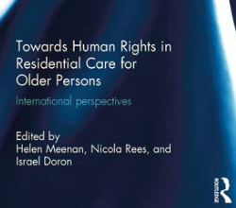
So, what can be learnt? The International Lessons
On the bright side
The awareness of the significance of LTC;
The importance of community/“aging in place”
The leadership and creativity in novel social support programs;
On the other side
The absence of a human rights legislation for support of independent living in old age;
The gaps between rhetoric and realities;
On the relevance of dignity to LTC: choice, control, affordability, social engagement;
On the impact of ageism on LTC;
The potential contribution of the specific international HR convention

Slide 9
Part II: But How Do We Know? The “Measurement” of LTC and “Comparison” Challenge and Lessons

Slide 10
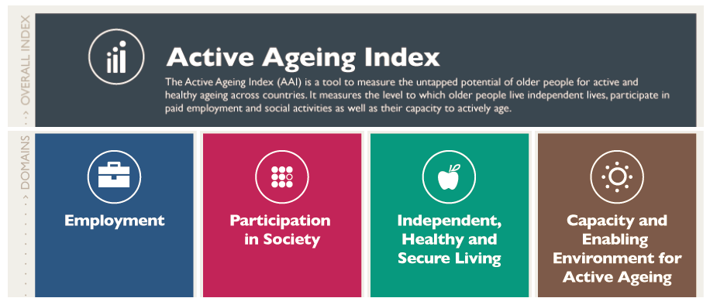
The Rise of Indexes
Can we “measure” Mr. Fredricksen’s LTC rights?
Why international indexes?
The rise of international aging indexes:
AAI
AgeWatch Index
AARP Livability Index
What was missing?
The invisibility of Human Rights in Old Persons’ Indexes

Slide 11
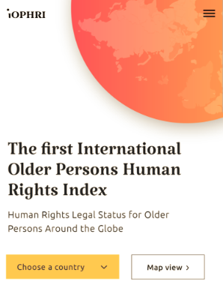
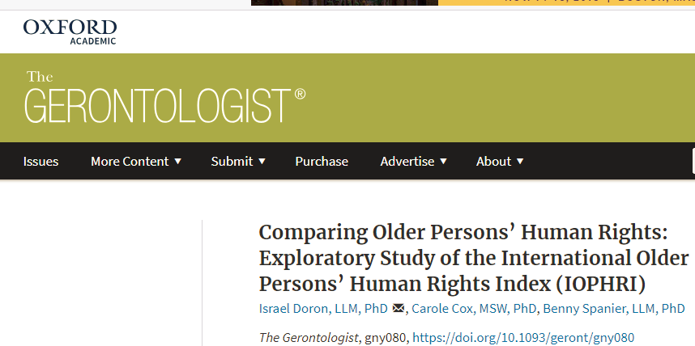
The iOPHRI Project
What is the IOPHRI project?
Doron, Cox, & Spanier + the Borchard Fountation
The iOPHRI and the OEWG
The iOPHRI and LTC
www.iophri.org

Slide 12
iOPHRI: LTC (work in progress – Do Not Cite)
The “parameters: 1. Community LTC; 2: Institutional LTC;
The “grades”: 0 – None; 1 – Very limited; 2. Some limitations; 3 Fully exists.
Very preliminary finding suggest that in all the countries examined, the human right to long term care in old age is not fully recognized

Slide 13
Part III: But what is unique in old age? From Theory, Evidence, and measurement to Ideology of Aging & LTC

Slide 14
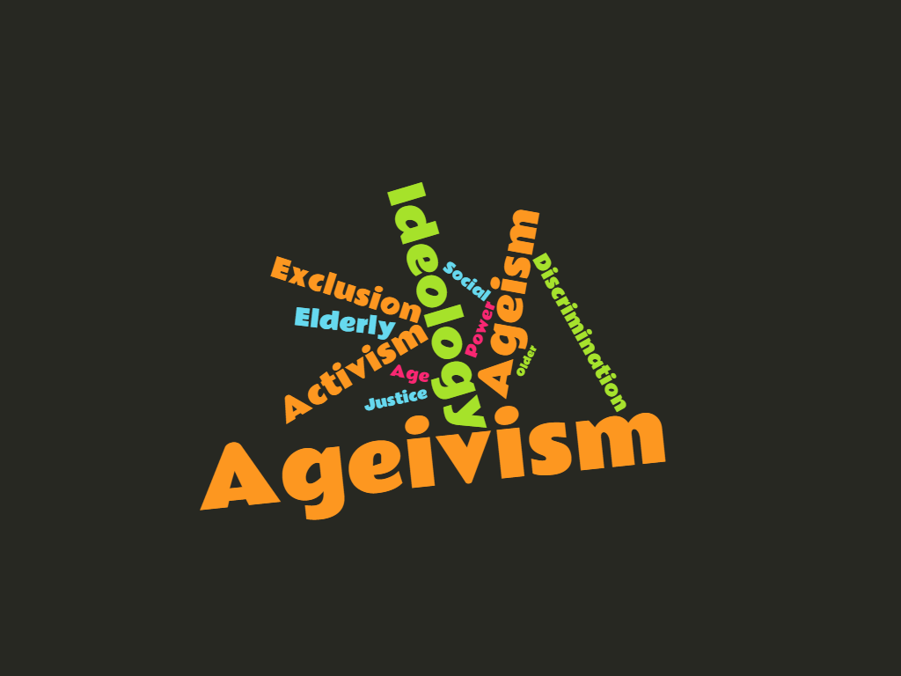
Why Ideology ?
The historical process;
The sources of ideology of old age
The understanding that there is a social identity of “older persons”
The realization that societies “construct” old age
The theoretical and empirical exposure of “ageism”
The adoption of the ideological lens of AGIVISM and the significance of a new, special, HR convention.
www.ageivism.org

Slide 15
Conclusion: So what would Mr. Fredricksen say if he were here today ?

Slide 16
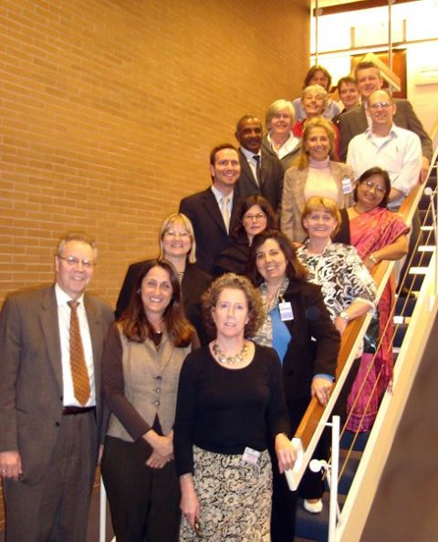
I would like to end with Some personal reflections:
Look at this picture: The 5/2009 UN Expert meeting in Bonn; The 12/2010 OEWG + my personal appearances; The 5/2014 UN HRC Independent Expert; The 6/2015 OAS IA Convention + the 1/2016 AU Protocol
There is the evidence for need;
There is the theory, and even the ideology;
There is a growing social movement
And we have moved to discuss substantive rights;

Slide 17
But, there is also great frustration:
It is time to “take off”: move from “talking” to “doing”

Slide 18
Thank You Prof. Israel Issi Doron

